Slide 1
2024 Election – super Tuesday outcomes “story of an election: Super Tuesday version” For : DATA607 – Project 3 March 19, 2024

Slide 2
AGENDA
What and Why: Why this topic and what are our goals
How: Data gathering, transformation, analyses
What they say
Lesson learned

Slide 3
The power of prediction <- What and Why
What
Variety of data for cross-checking: Super Tuesday matters for the outcome of the election and rich data is available
Voter Insight: It reflects the voter behavior and campaign effectiveness
Pattern discovery: Uncover patterns that reveal the electorate’s pulse and the resonating impact of political messaging.
Why:
Voter Turnout: a window to voter’s behaviors
Demographics and how people vote, what resonates with voters, and patterns matter
Data could be used for predictive model (Future work)
Our Goals and Hypothesis:
Data Management: Streamline the collection, cleaning, and organization of data;
Insightful Reporting: Generate detailed statistical summaries and visualizations;
Strategy Assessment: campaign effectiveness by analyzing voter turnout data.
Present summary statistics, and present useful graphs that eventually can be used for a predictive model
Hypothesis to explore: Hypothesis 1: The issue of abortion does not critically sway the election results; Hypothesis 2: For independent voters, the presidential candidate’s age is secondary to their position on abortion.
Notes:
Why we chose this topic, what question we wanted to answer, what we expected to get done, and why it is important (hypothesis and goals)
Your data science project on Super Tuesday is a fascinating choice! Here are some recommendations and help for answering your questions:
Topic Choice: Super Tuesday is a key event in the U.S. political process, offering rich data for analysis. It reflects voter behavior and the effectiveness of political campaigns, making it a valuable study subject.
Key Questions: You might explore which factors influence voter turnout, how demographics affect voting patterns, or the impact of media coverage on election results.
Expected Outcomes: Your team could aim to create predictive models, analyze voter sentiment, or identify key indicators of electoral success.
Importance: Understanding these elements can provide insights into democratic processes and inform future political strategies. Your hypothesis might focus on the predictive power of certain variables, with goals to enhance the accuracy of election forecasting.

Slide 4
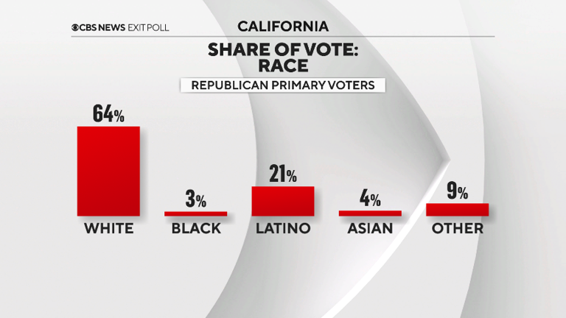
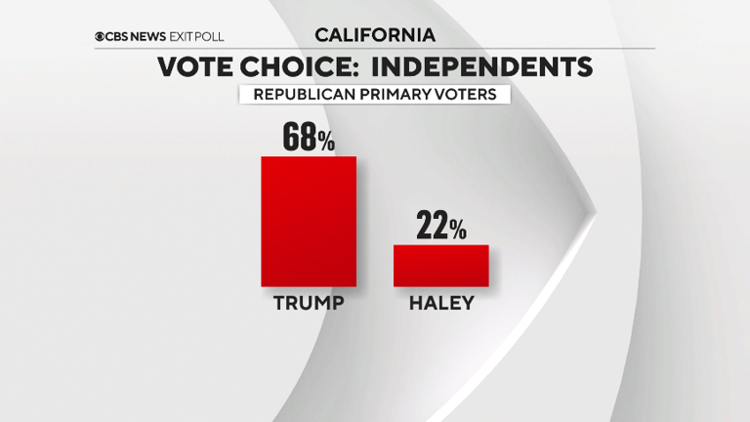
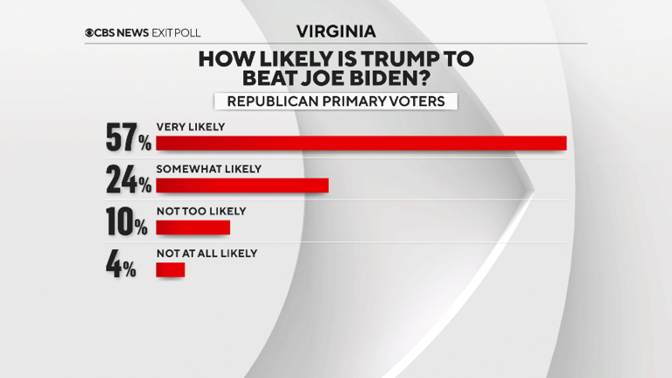
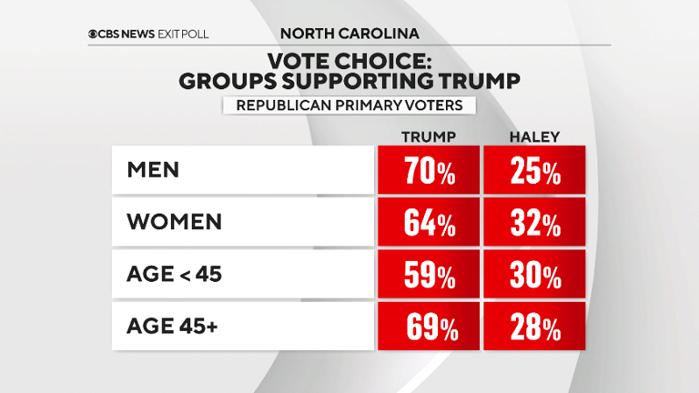
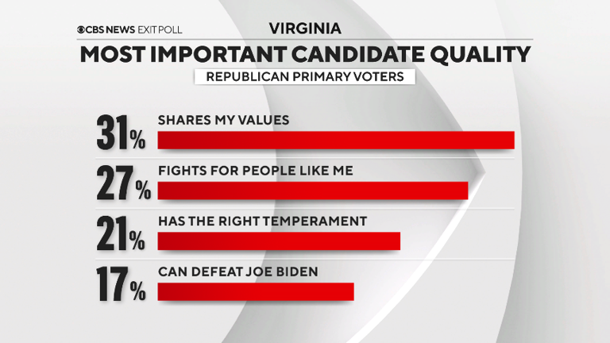
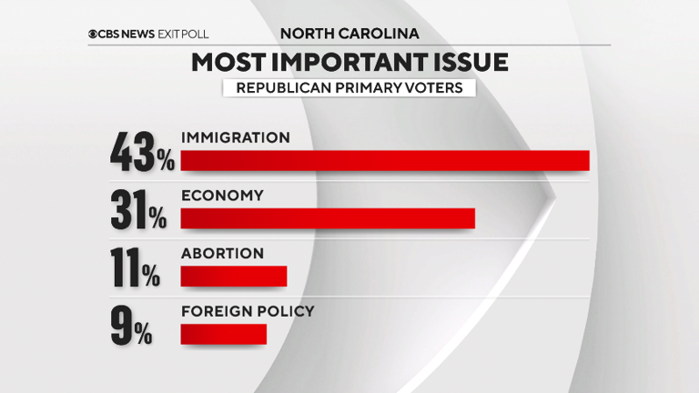
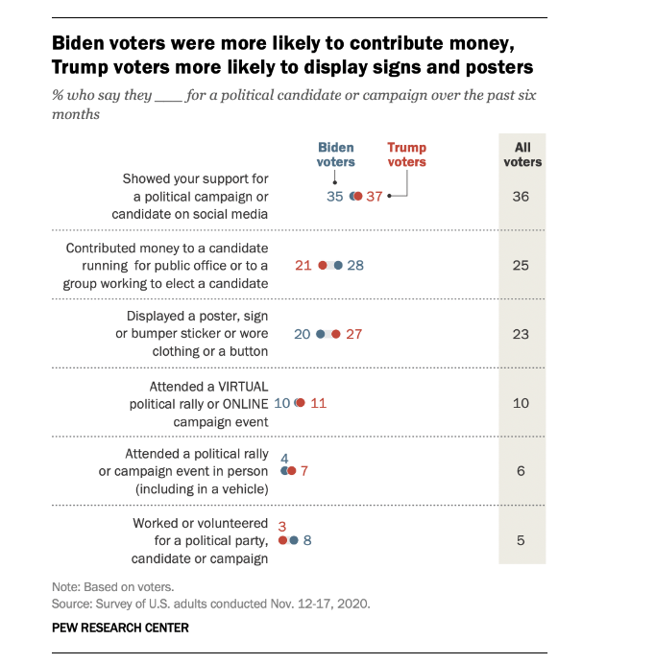
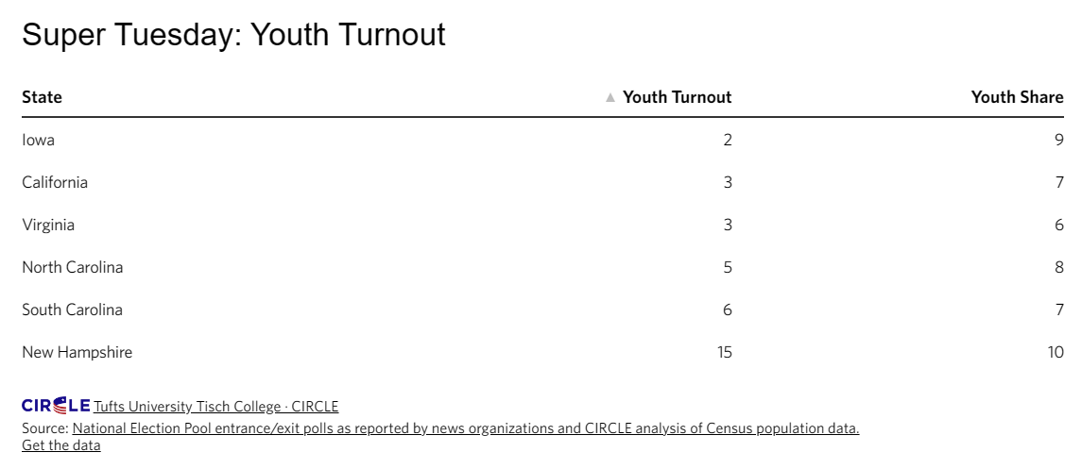
What others do?
Notes:
Super Tuesday exit polls and analysis for the 2024 primaries (msn.com)
Super Tuesday: Youth Turnout Low in North Carolina, Virginia, and California | CIRCLE (tufts.edu)
Key findings about voter engagement in the 2020 election | Pew Research Center

Slide 5
How: How we gather the data
Ballotpedia.org had the actual number of votes cast for each candidate in each state. However, it was structured in tables and tabs, making it difficult to manage.
World Population Review had the data we needed for state level voter registration for all fifty (50) states. This included number of registered voters and percentage of voting age population.
The Ballotpedia.org data was read into R, and imported into a table matrix using an identified node (‘.portal.section’) and table names given for each of the states.
The World Population Review data was available in CSV format.

Slide 6
What: What we did
Made data available through GitHub for the R Markdown file.
Tidy and Transformed the Ballotpedia dataset.
Linked the Ballotpedia and World Population Review data dets.
Analyzed and Visualized the data.
Discussed some of our results.
Learned some lessons.

Slide 7
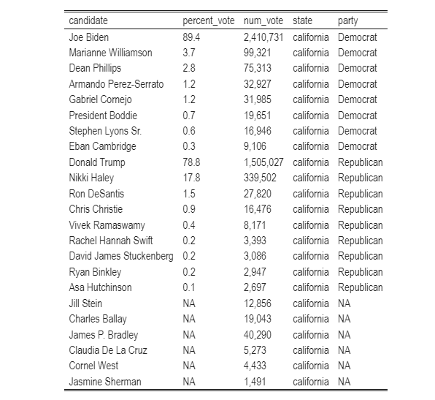
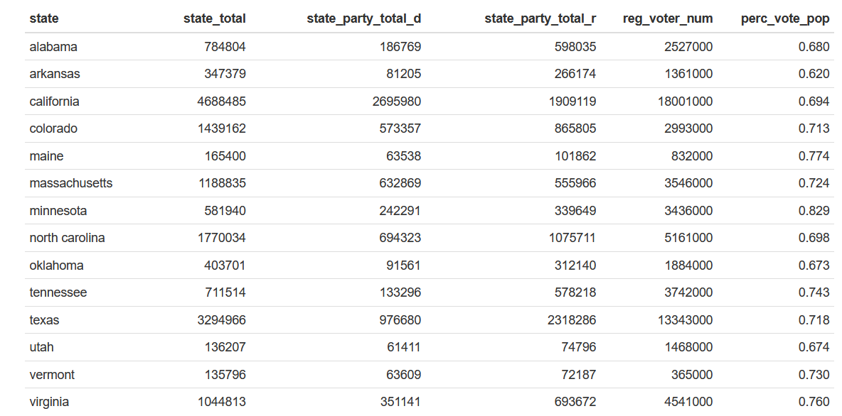
Observations and analyses
Tabulated data: The largest proportion to grab is Nikki Haley’s, who can attract them, and how? What matters to them?
Only in two states of super Tuesday Democrats turn out were higher than Republicans, on the rest Republicans were decisively more

Slide 8
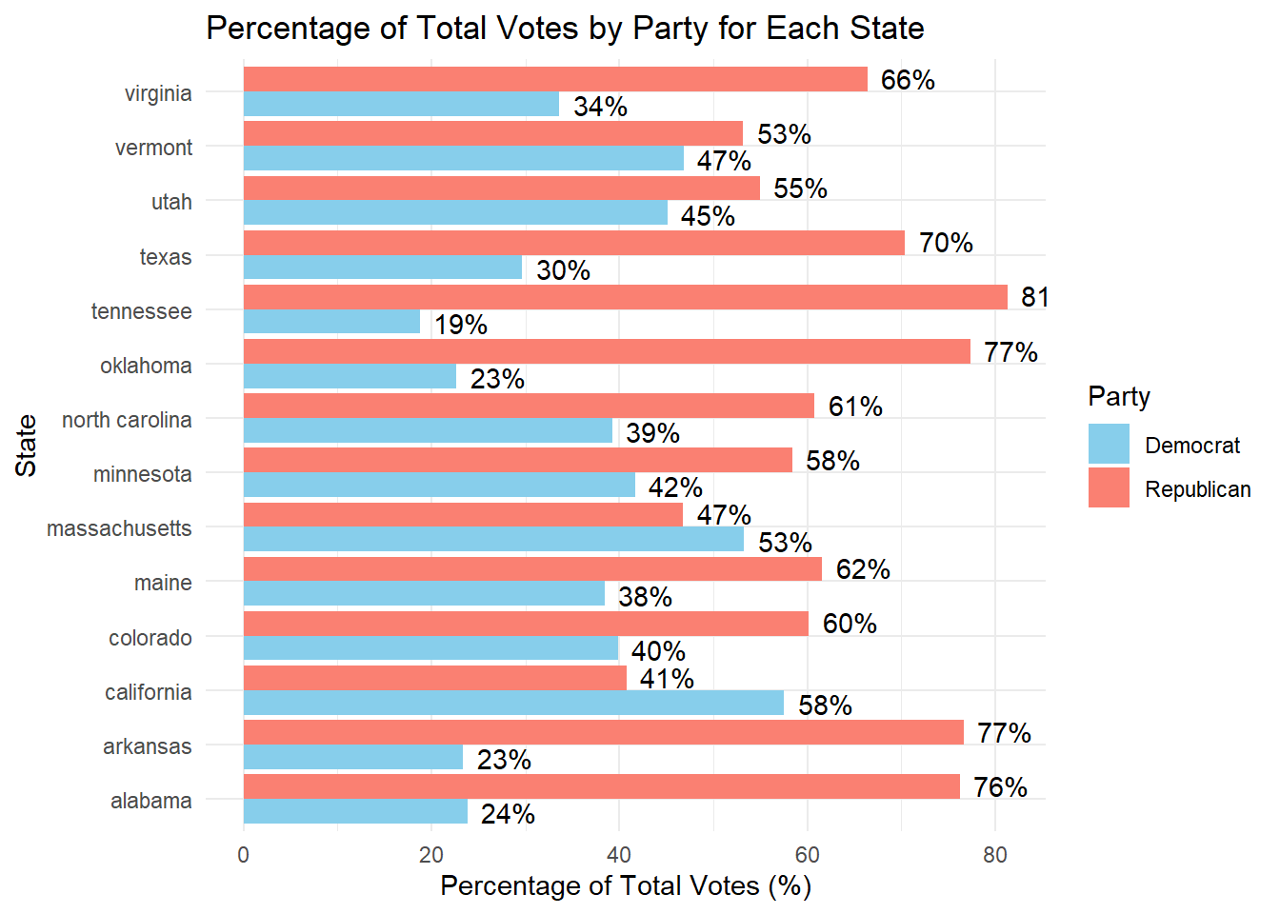
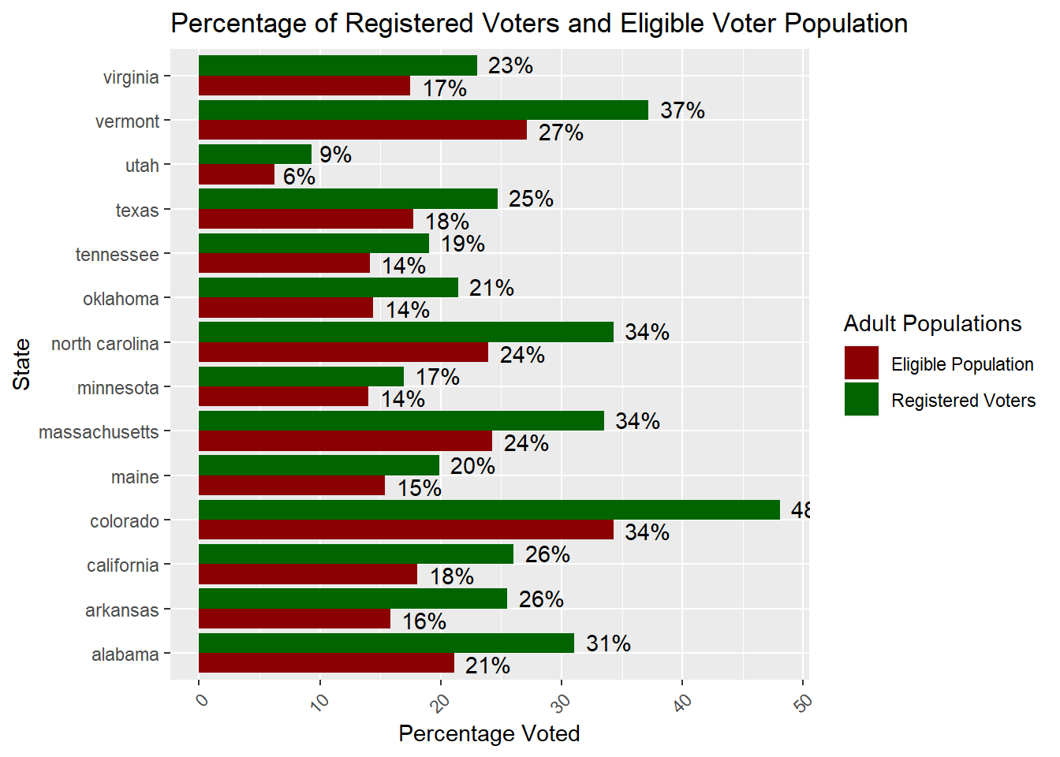
What State matters
States that voter may matter: Vermont, Utah, Massachusetts, (difference below 10%)
Registered vs total, what kind of inference we can make?
Notes:
Appears to enthusiasm in current republicans, but some in the margin of error can be flipped back
Majority of voter didn ot came out yet, only third elecyt the presudemt

Slide 9
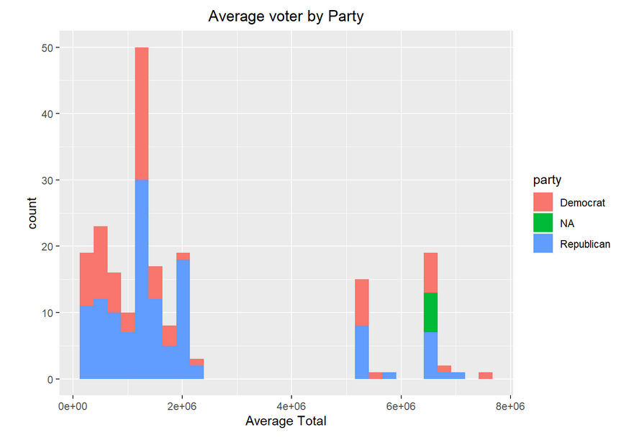
What conclusion we can make of Average voter?

Slide 10
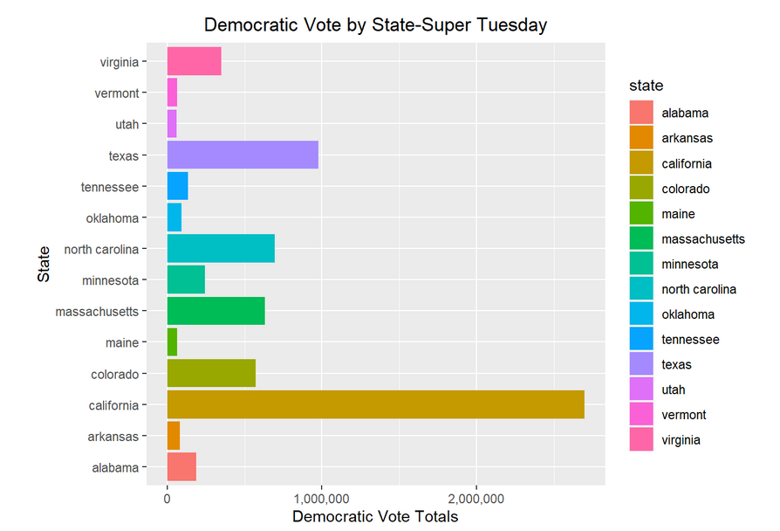
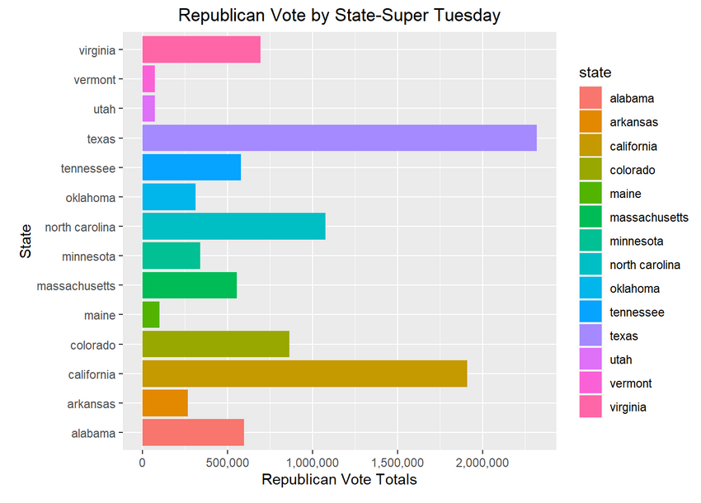
Voter Turnout – What data says about enthusiasm?
Notes:
See the state in California even it is Democratic, there were a lot enthisiam in the republican, not unpecident of the stae , and vermon or massaachussets

Slide 11
Results: What results say
Registered Republican turnout was 10% or higher than Democrat in most Super Tuesday States, with the exception of Massachusetts, California, and Vermont. Utah had the least voter turnout of all the states, with less than 10% of the registered voters participating.
Voter participation on Super Tuesday was on average 26% of the total number of registered voters. This indicates only a small portion of the voting public is selecting a candidate.
Voter participation on Super Tuesday was on average 18% of the total eligible population. This indicates that an even smaller portion of the public is actually selecting a candidate. The U.S. Census Bureau estimates that 154.6 million people voted in the last election, about 65% of the total eligible population that can vote (258.3 million)
Independent voters make up 30-40% of the registered voters and have not been analyzed in this project. In the 2020 election, it was an almost even split with the Democratics candidate ahead slightly and within the margin of error.
While we may be looking at party registered voting on Super Tuesday, the information does not provide a definitive answer as to how people will vote on election day, including that of the independent voters. (i.e.-Nikki Haley voters going to republican or democratic candidate, or sitting out the election)

Slide 12
Lesson learned
Don’t get into politics!
Working in a team requires planning and dedication, people have different interests and strengths, takes time to figure out who does what good.
Have a plan, see what others do, and learn from it to plan your analyses
Good data is available but getting them and organizing them is difficult, and requires extra attention, and understanding of the structure of the data
Notes:
What is our take from he project, what would we do differently, what we did well, and what we have learned

Slide 13
Sources & Referecnes
[1]: GitHub: https://github.com/kohyarp/DATA607_Project3
[2]: Rpub: https://rpubs.com/kohyarp/1163803
[3]:https://electionlab.mit.edu/articles/voter-confidence-and-electoral-participation
[4]: https://time.com/6223871/midterms-voting-turnout-results/
[5]:https://escholarship.org/content/qt83s3p2t2/qt83s3p2t2_noSplash_5f3d629c82c3feb4af00babba1b97e8d.pdf
[6]: Ballotpedia’s Super Tuesdayprimaries(https://ballotpedia.org/Super_Tuesday_primaries,_2024)
[7]: worldpopulationreview(https://worldpopulationreview.com/state-rankings/registered-voters-by-state).
[8]: https://www.census.gov/newsroom/press-releases/2022/2020-presidential-election-voting-report.html
[9]: https://www.pewresearch.org/politics/2019/03/14/political-independents-who-they-are-what-they-think/

Slide 14
THANK YOU
Team:
Anthony C. , James N, Koohyar P., and Victor T.

